Slide 1
E- MUSIC USING AI
INFOSYS SPRINGBOARD INTERNSHIP 5.0
: PYTHON TECH STACK
COURSE
MENTOR NAME : MR. J.MOHAMMAD THARIK

Slide 2


INTRODUCTION
The E-Music Application powered by AI is an innovative platform designed with cutting-edge AI algorithms and transforms your musical ideas into masterpieces for seamless sound creation and personalization and every note reflects your unique style.
Purpose:
Suggest music based on listening habits or tailor music to suit individual tastes.
Combine different genres and sounds to create unique tracks.
Makes it easy to share music with friends, fans, or social media platforms.

Slide 3



FEATURES
Easy Music Creation
Create music using virtual instruments
and sounds.
AI Suggestions
Get music ideas and suggestions from AI to help you create faster.
Music Templates
Start with pre-designed music templates for different genres.
Mix Tracks
Combine and adjust different music tracks to make them sound perfect.
Share Music
Easily share your music on social media or music platforms.

Slide 4





TECHNICAL STACK
Frontend : HTML
Backend : Django
Database : SQLite
API Integration : Spotify API
Libraries Used:
HTML5 : Building structure of web pages
Bootstrap : For responsive design.
CSS3 : For styling the user interface.
Django Allauth : For user authentication
Django Crispy Forms
SQLite3

Slide 5
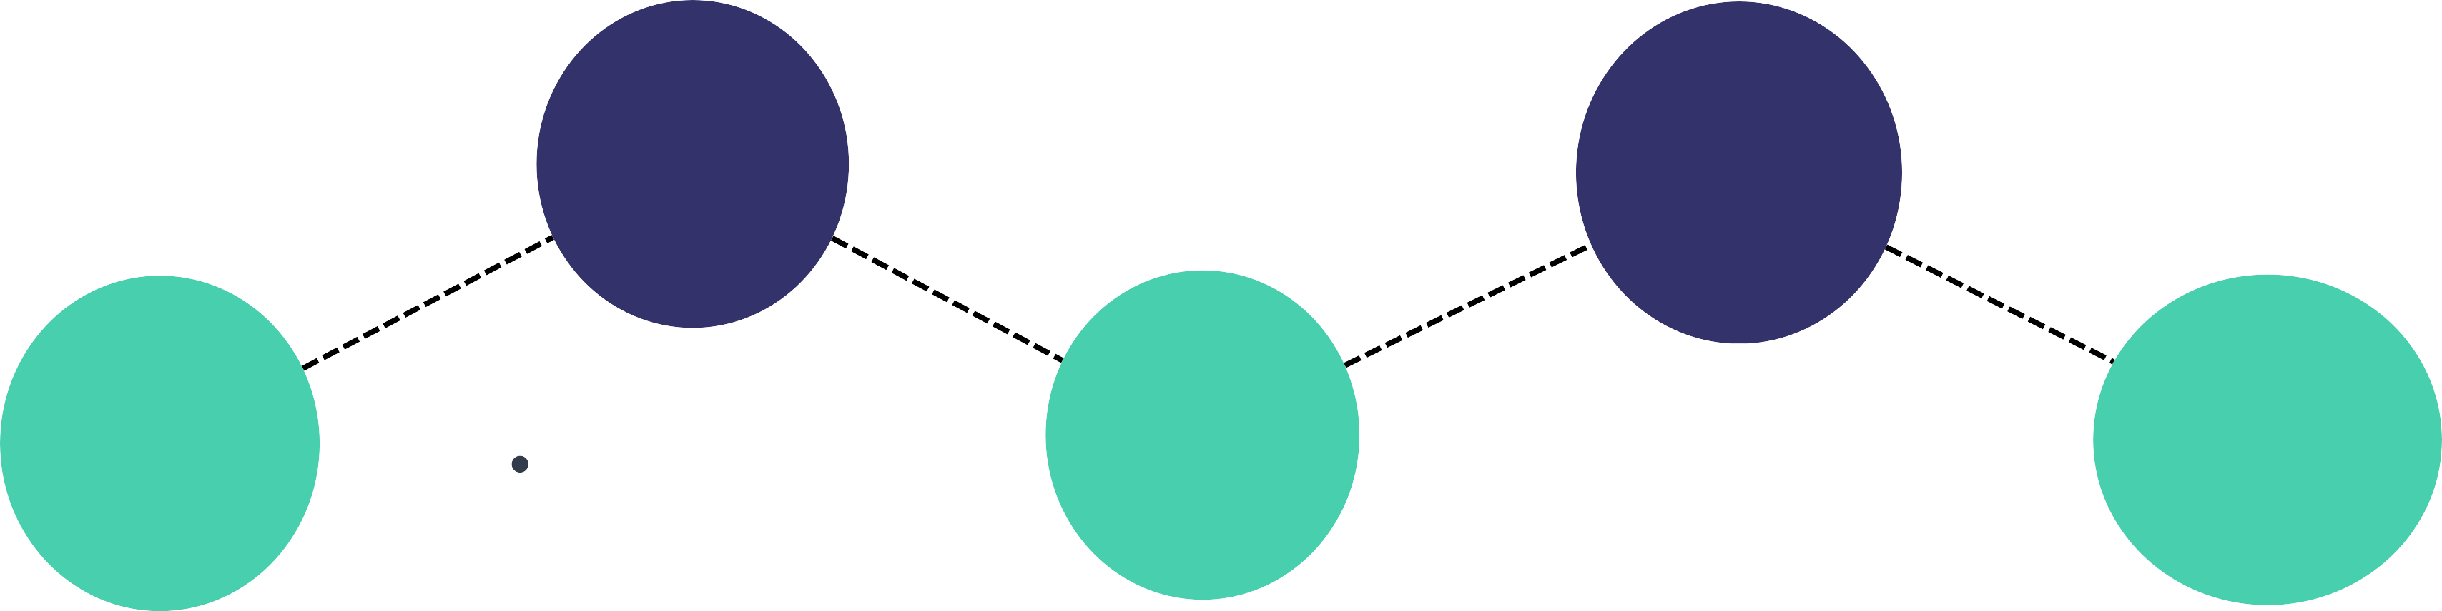
DEVELOPMENT PROCESS
Subscription &
Genres of music
Subscription pack , categories or songs and genres
User Login and Management
Registration, login, and signup.
WEEK 3-4
WEEK 7-8
PROJECT COMPLETION
WEEK 1-2
WEEK 5-6
Review, Testing, and Documentation
Unit testing, bug fixes, and documentation preparation.
COMPLETION
Dashboard Management
Contact us , About us and Home page

Slide 6



UI OVERVIEW
LOGIN
Displays authentication process for user and admin
GENRES OF MUSIC
Allows users to easily discover and enjoy music based on their preferences.
HOME PAGE
Displays features and navigation options.
TEMPLATES
About us , Contact us and Subscription packs
DASHBOARD
Offers a tailored music experience, providing insights into user preferences
USER MANAGEMENT
Admin manages users (enable/disable) and permissions.

Slide 7
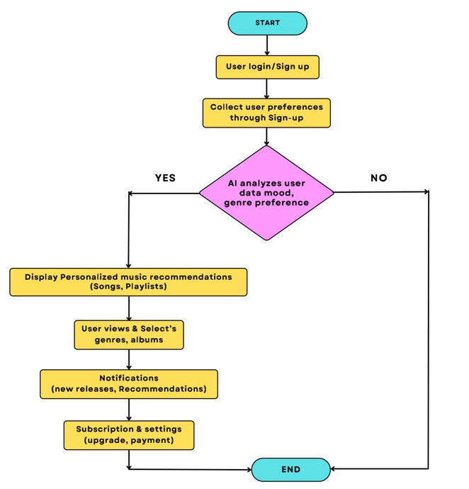

WORKFLOW

Slide 8

TESTING
APPROACH
Unit Testing: Individual features are tested.
Integration Testing: Backend logic and Spotify API call are tested.
System Testing: End-to-end validation of workflows.
Outcomes:
Personalized music recommendations.
Discover new music, creates custom playlists.
Encourages sharing music, exploring new artists.

Slide 9



BENEFITS
Personalized Experience
Better Music Discovery
Enhanced User Management
Dynamic Playlists
Higher Audio Quality
Mood Matching
LIMITATIONS
Music Licensing Restrictions: The availability of certain tracks, albums, or artists may be restricted due to licensing agreements.
Internet Dependency: Requires a stable connection for core functionalities.
Subscription Dependency: Many advanced features (ad-free experience, exclusive content) may be locked behind premium subscriptions, limiting the free version's appeal.

Slide 10




CONCLUSION
E-Music can become a leading choice for music lovers seeking personalized and smart music streaming
Key achievements include:
Tailored song and playlist recommendations
Automated mood based and activity specific playlists
Better audio quality and performance
Impact:
AI in E-Music revolutionizes music discovery, enhances engagement, and supports the growth of the music industry.

Slide 11
THANK YOU
INTERNS :
DEEPTHISREE S
RESHMI SUBHA GKR
BHARAT KOLHE
RAMAKOTI ABHIRAM SHARMA
NAGANATHAN S
VIVIN LOBO

